Slide 1

ASHoKA WOMEN’S ENGINEERING COLLEGE SMS SPAM DETECTION
PROJECT GUIDE
T.MURALI KRISHNA
Asst.Prof in CSE, ASKW
BY
SOWMYA KRISHNA.T 192T5A0503
JYOTHSNA.P 182T1A0582
PAVANI.T 182T1A05A8
PRAVALLIKA.P 182T1A0583

Slide 2
Contents
Abstract
Introduction
Existing System
Proposed System
Modules
Algorithm
Architecture
Requirements
Input and Output
Conclusions
References

Slide 3
Abstract
Spam SMSes are unsolicited messages to users, which are disturbing and harmful.
Spam messages also called junk or unwanted messages that can be used to harm any user by wasting their time, stealing valuable information.
The efficient spam detection is an essential approach which help people to classify whether it is a spam SMS or not.
Several machine learning algorithms have been used for this purpose , i.e, Naive Bayes, Decision trees.

Slide 4
Introduction
The spam detection is a big issue in mobile message communication due to which mobile message communication is insecure.
Spam is any irrelevant or unwanted message or email sent by the attacker,
Spam sms may include advertisements of drugs, software, health insurance or fraudulent messages or advertisements.
We can classify messages into spam and nonspam messages by using feature extraction from messages headers, subject and body. After that we can group them into spam or ham.
Inorder to tackle this problem,an accurate and precise method is needed to detect the spam in mobile message communication.

Slide 5
Existing System
To avoid Spam SMS people use White and Black list of numbers,but this technique is not completely avoid Spam SMS.
Detecting bulk amount of spam messages takes time .
To tackle this problem needs smart technique which correctly identifies Spam sms.

Slide 6
Disadvantages
Users need to select features manually.
Complex implementation.
No classification algorithm is used.

Slide 7
Proposed System
Natural language processing technique is useful for SMS Spam identification.It analyses text content and finds patterns which are used to identify Spam or Non-Spam.
Multinomial Naive Bayes used to calculate a probability that an email is or not spam.
Compared to other algorithms Multinomial Naive Bayes gives high accuracy score.

Slide 8
Advantages
Help to keep garbage out of email inboxes.
Naive Bayes is more feasible for mobile applications.
Lower memory usage.
Fast to execute,high efficiency

Slide 9
modules
Data Loading
Data pre processing
Model Building
Saving the model
Integration with flask application

Slide 10
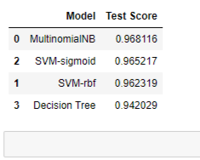
algorithm
Algorithms used for spam detection and their accuracy according to their performance.

Slide 11
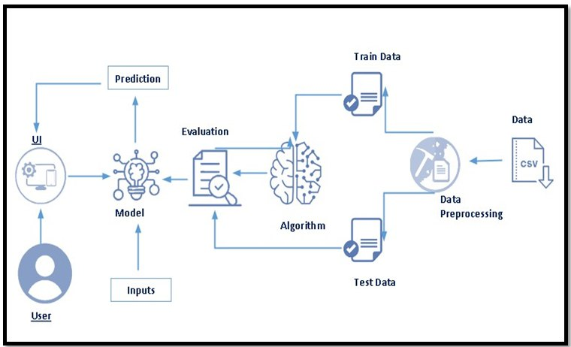
Architecture

Slide 12
System Requirements
Hardware
RAM : 8 GB
Processor: Intel Core i5
Hard Disk:40 GB

Slide 13
Software
Operating system : Windows 10/11.
Coding Language : Python 3.6.8
IDE : JUPYTER and SPYDER
Database : EXCEL

Slide 14

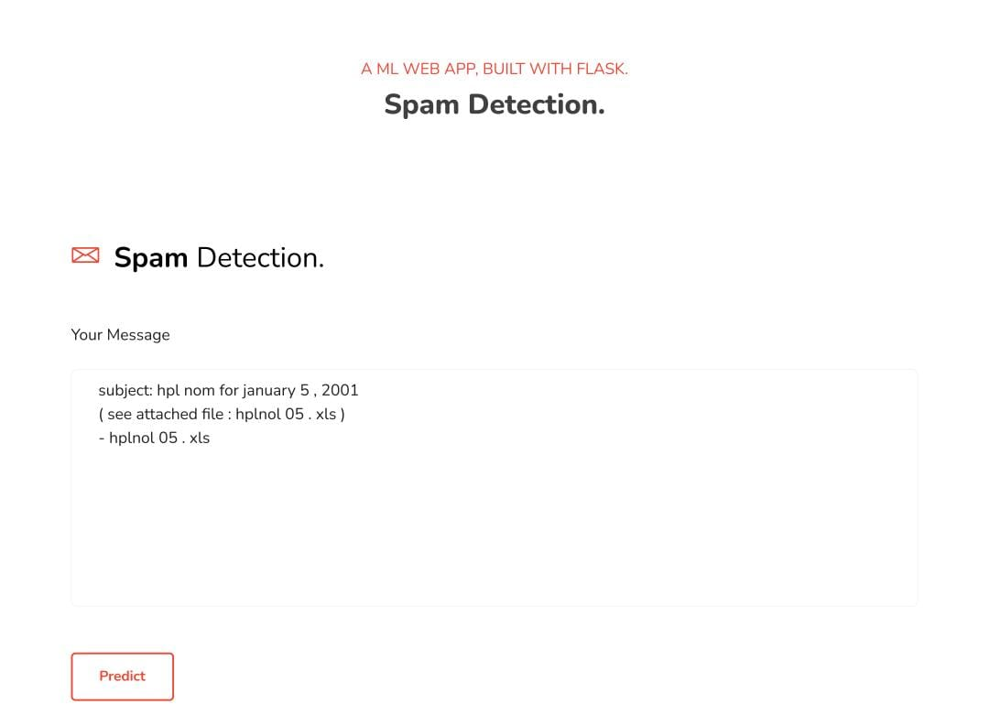
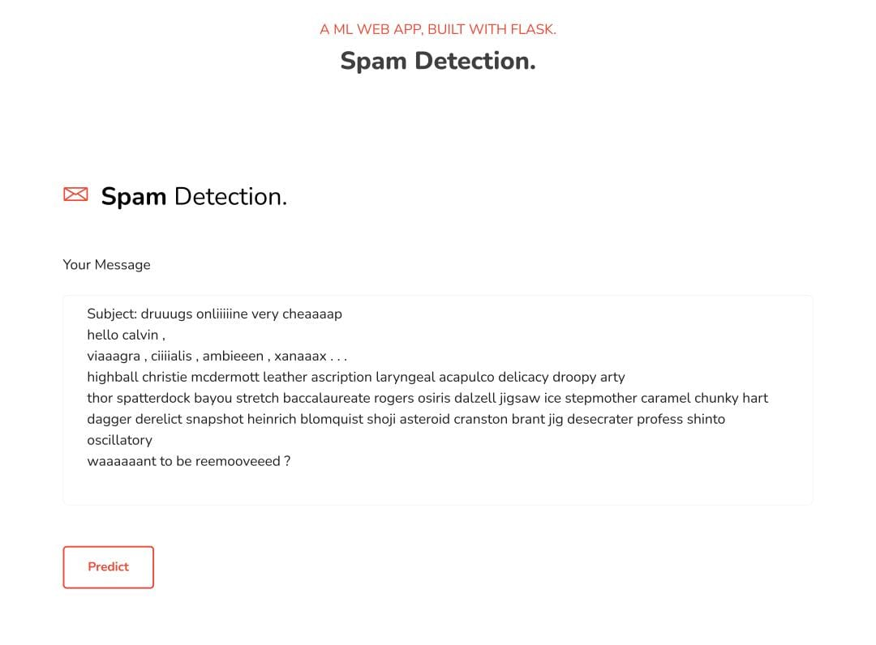
Input 1

Slide 15
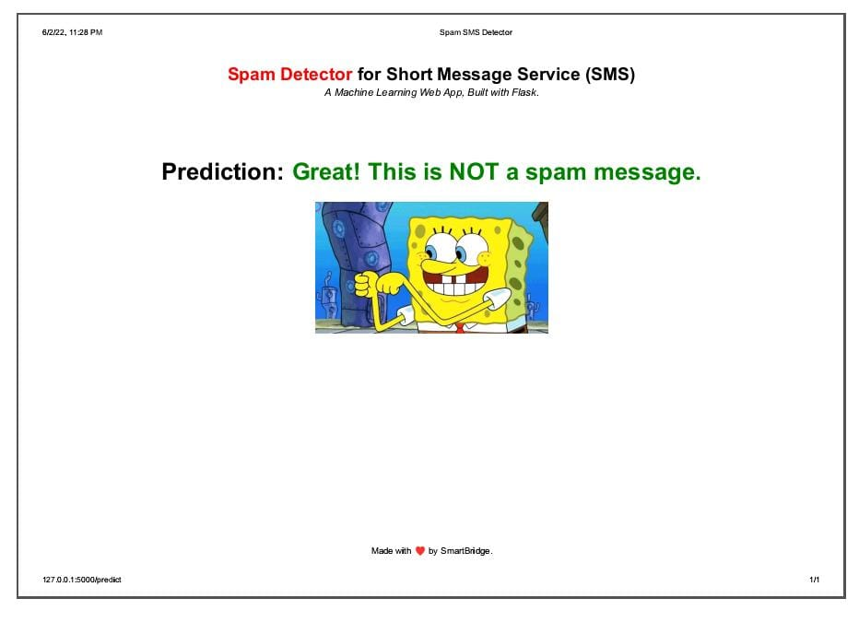
Output as not a spam

Slide 16
Input 2

Slide 17
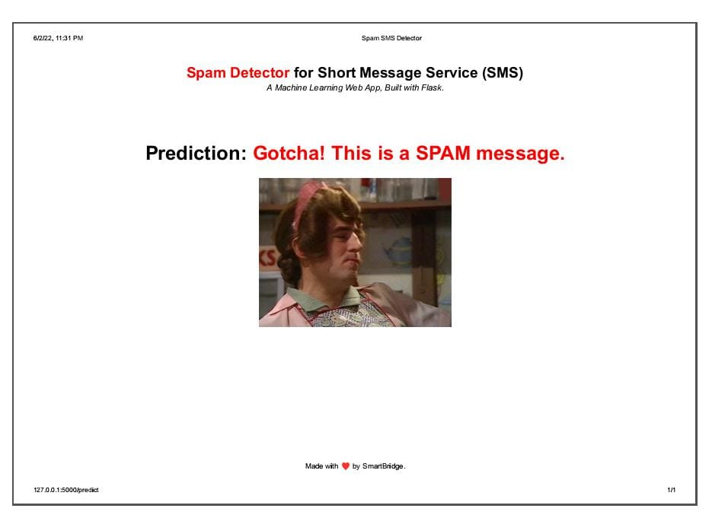
Output as a spam

Slide 18
conclusion
Spam detection is used to help keep garbage out of email inboxes.
To detect the unwanted and virus-infected email messages and prevent these messages from getting to a users inbox.
From these experiential results analysis, we concluded that the Multinomial NaiveBayes algorithm effectively classifies the ham and spam because the achieved accuracy is high.

Slide 19
References
Press Release, Growth Accelerates in the Worldwide Mobile Phone and Smartphone Markets in the Second Quarter, According to IDC, ”http: //www.idc.com/getdoc.jsp?containerId=prUS24239313”
SMS Spam Collection v.1, ”http://www.dt.fee.unicamp.br/∼tiago/ smsspamcollectio
Tiago A. Almeida, Jos Mara G. Hidalgo, and Akebo Yamakami. 2011. Contributions to the study of SMS spam filtering: new collection and results. In Proceedings of the 11th ACM symposium on Document engineering (DocEng ’11). ACM, New York, NY, USA, 259-262. DOI=10.1145/2034691.2034742 http://doi.acm.org/10.1145/2034691.2034742
SMS Spam Collection Data Set from UCI Machine Learning Repository, ”http://archive.ics.uci.edu/ml/datasets/SMS+Spam+Collection”

Slide 20
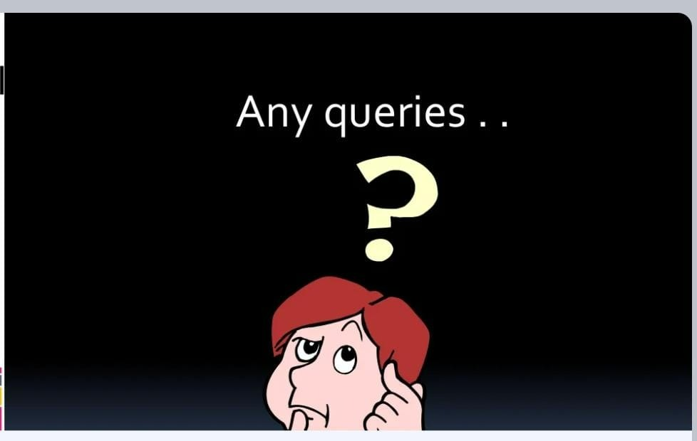

Slide 21


